Slide 1

Neural Networks
from Scratch
Session 1: Foundations & Forward Propagation

Slide 2

Session 1 Agenda
Biological Inspiration: Understanding the origins of artificial neurons.
The Perceptron: Weights, biases, and the fundamental unit of learning.
Activation Functions: Introducing non-linearity (Sigmoid, ReLU).
Forward Propagation: Passing data through the architecture.
Lab 1: Building the forward pipeline in NumPy.

Slide 3

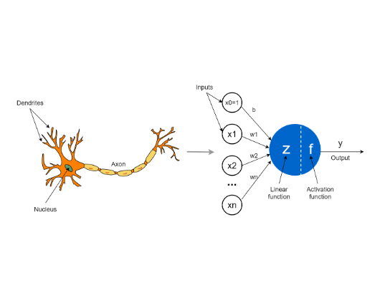
What is a Neural Network?
Artificial Neural Networks (ANNs) are computing systems inspired by the biological neural networks that constitute animal brains.
Just as biological neurons receive signals via dendrites and transmit them via axons, artificial neurons receive numerical inputs, apply a mathematical transformation, and pass the output forward.
This biomimicry allows modern algorithms to recognize complex patterns in vast amounts of data.

Slide 4


The Perceptron Concept
Weights & Bias
Linear Transformation
A perceptron computes a weighted sum of its inputs. The weights dictate the importance of each input feature. The bias shifts the activation threshold, allowing the model to fit data that doesn't pass through the origin.
Mathematically, the core of a neuron is a simple linear equation. However, a purely linear system, no matter how deep, acts merely as a single linear transformation. We need a way to capture complex relationships.

Slide 5






Activation Functions
Sigmoid
ReLU
Tanh
Squashes values between 0 and 1. Great for output layers in binary classification, but suffers from the vanishing gradient problem in deep networks.
Rectified Linear Unit outputs the input if positive, else zero. It is highly computationally efficient and mitigates vanishing gradients.
Similar to Sigmoid but squashes values between -1 and 1. Generally preferred over Sigmoid for hidden layers as data is centered around zero.

Slide 6
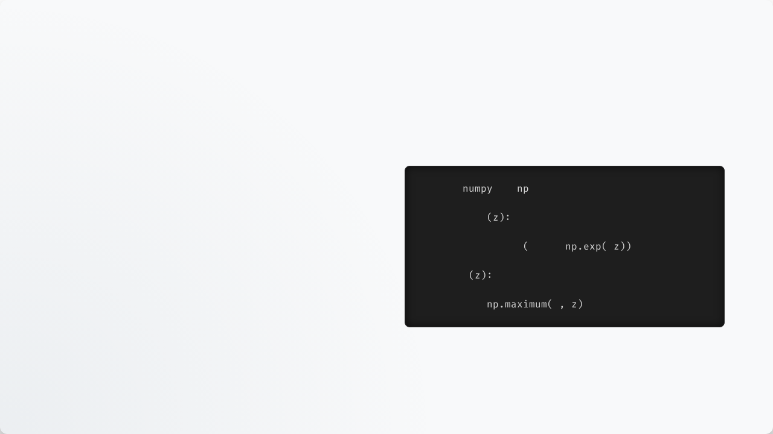
Code: Sigmoid & ReLU
NumPy Implementation
import
as
Building neural networks from scratch requires us to define these mathematical functions in code. We rely heavily on NumPy for fast, vectorized operations.
def
sigmoid
# Maps any real value into (0, 1)
return
1.0
/
1.0
+
-
By using NumPy arrays, we avoid slow Python loops and perform calculations over entire datasets simultaneously.
def
relu
# Returns max of 0 and input
return
0

Slide 7
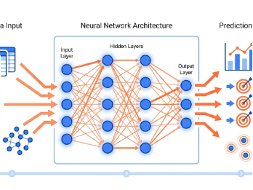


Network Architecture
Input Layer
Hidden Layers
Output Layer
Receives raw data features.
Extracts hierarchical patterns.
Produces final predictions.

Slide 8
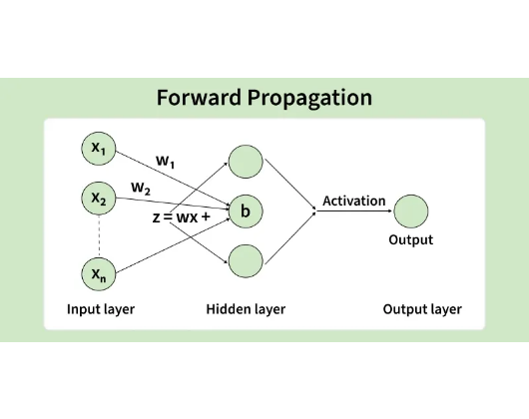
Forward Propagation
Forward propagation is the process of passing input data sequentially through the network's layers to generate a prediction.
At each layer, the network computes the dot product of the inputs and weights, adds the bias, and applies the activation function.
The output of one layer becomes the immediate input for the next layer.

Slide 9


Math of Forward Pass
Linear & Non-Linear Steps
For a given layer, we first compute the linear combination (Z). We represent inputs as X (or A from the previous layer), Weights as W, and bias as b.
Next, we pass Z through our chosen activation function (denoted by sigma) to get the activation output (A).

Slide 10
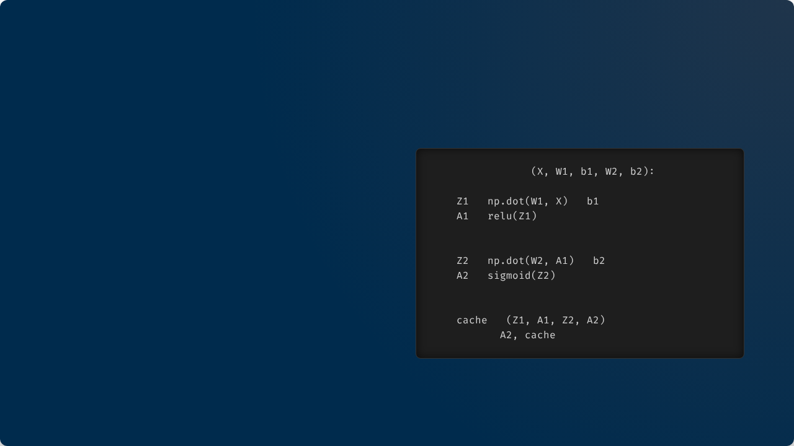
Code: Forward Pass
Building the Pipeline
def
forward_prop
Here we define a 2-layer network forward pass.
# Layer 1
=
+
Notice how we save a cache of intermediate variables (Z1, A1, Z2, A2). We will desperately need these values later when we calculate gradients during backpropagation.
=
# Layer 2
=
+
=
# Store values for backprop
=
return

Slide 11


Loss Functions
Mean Squared Error (MSE)
Binary Cross-Entropy
Calculates the average squared difference between predictions and actual targets. It is the standard loss function used for continuous numerical regression tasks.
Measures the performance of a classification model where output is a probability between 0 and 1. It heavily penalizes confident but incorrect predictions. Used for classification.

Slide 12
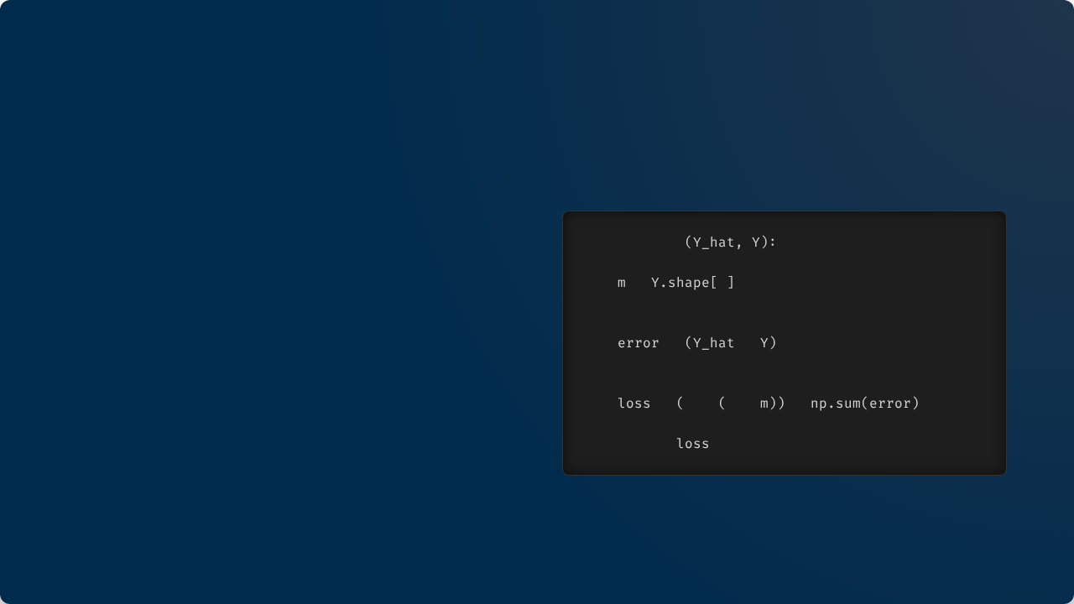
Code: MSE Loss
Measuring Error
def
mse_loss
To evaluate how well our network is performing, we implement the Mean Squared Error (MSE).
# Y_hat: predictions, Y: true labels
=
1
The variable m represents the number of training examples in our dataset. We divide by 2*m to make the derivative cleaner later on.
# Compute squared error
=
-
**
2
# Average over all examples
=
1
/
2
*
*
return

Slide 13
Lab 1 Introduction
Constructing the Forward Architecture

Slide 14
Lab 1 Tasks
Environment Setup: Initialize your Jupyter notebook and import NumPy.
Parameter Initialization: Write a function to randomly initialize W1, b1, W2, and b2 with the correct matrix dimensions.
Activation Functions: Code the Sigmoid and ReLU functions.
Forward Pipeline: Combine these elements to push dummy input data X through the network and print the output shape.

Slide 15
Questions?
End of Session 1 Theory

Slide 16
Neural Networks
from Scratch
Session 2: Backpropagation, Optimization & Training

Slide 17
Session 2 Agenda
The Learning Problem: Visualizing the loss landscape.
Gradient Descent: Mathematical optimization and updating weights.
Backpropagation: Applying the calculus chain rule.
The Training Loop: Putting the entire puzzle together.
Lab 2: Training the network on data.

Slide 18
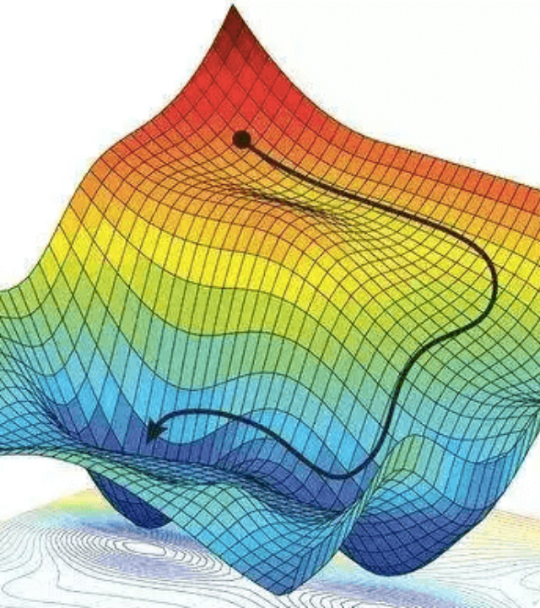
The Learning Problem
Training a neural network is an optimization problem. Our goal is to find the exact combination of weights and biases that minimizes the overall loss.
Imagine a complex, multi-dimensional hilly landscape. The "altitude" represents our error. We need to find the lowest possible valley.

Slide 19
Gradient Descent
The Gradient
Learning Rate (α)
The gradient is a vector containing partial derivatives. It points in the direction of the steepest ascent of our loss function. To reduce error, we step in the opposite direction of the gradient.
A hyperparameter that determines the size of the step we take. If it's too large, we overshoot the minimum. If it's too small, training takes forever or gets stuck.

Slide 20
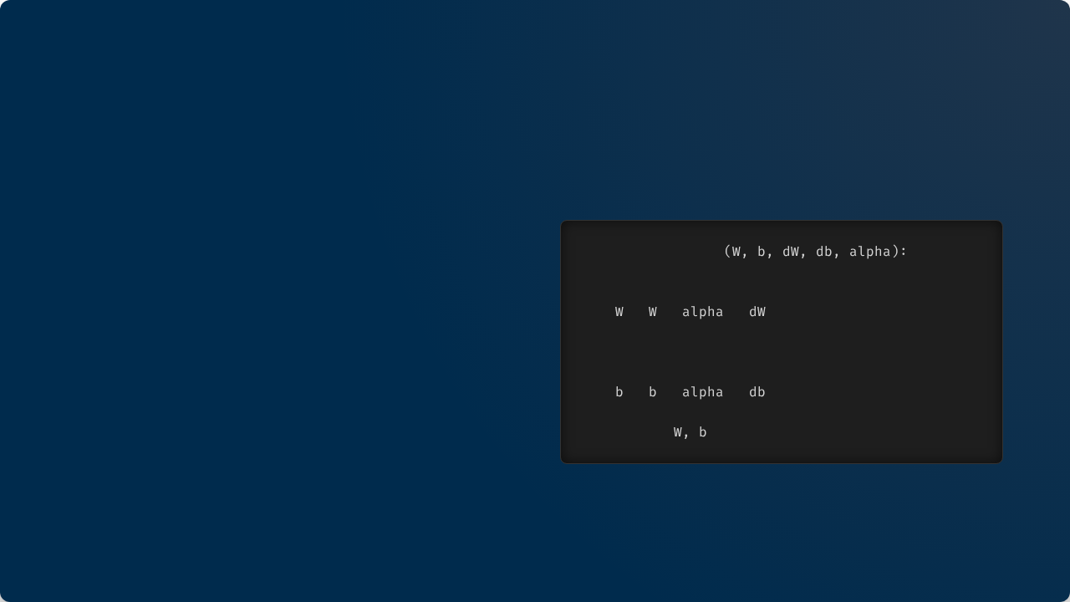
Code: Parameter Update
Applying the Rule
def
update_params
Once we calculate the derivatives (dW, db) using backpropagation, updating the parameters is a simple subtraction.
# W_new = W_old - (learning_rate * gradient)
=
-
*
# b_new = b_old - (learning_rate * gradient)
alpha represents our learning rate.
=
-
*
return

Slide 21
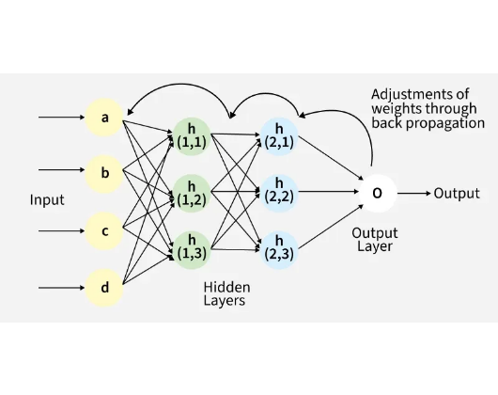
Backpropagation Intuition
Backpropagation is the heart of Neural Network training. It tells us exactly how much a change in a specific weight will impact the final loss.
It works backwards from the output layer to the input layer, distributing the "blame" for the error across all the weights using the calculus Chain Rule.

Slide 22


Math of Backpropagation
The Chain Rule
To find the derivative of the Loss (L) with respect to a Weight (W), we must multiply the derivatives of all intermediate operations.
This sequential multiplication is efficiently calculated from right to left (output to input).

Slide 23
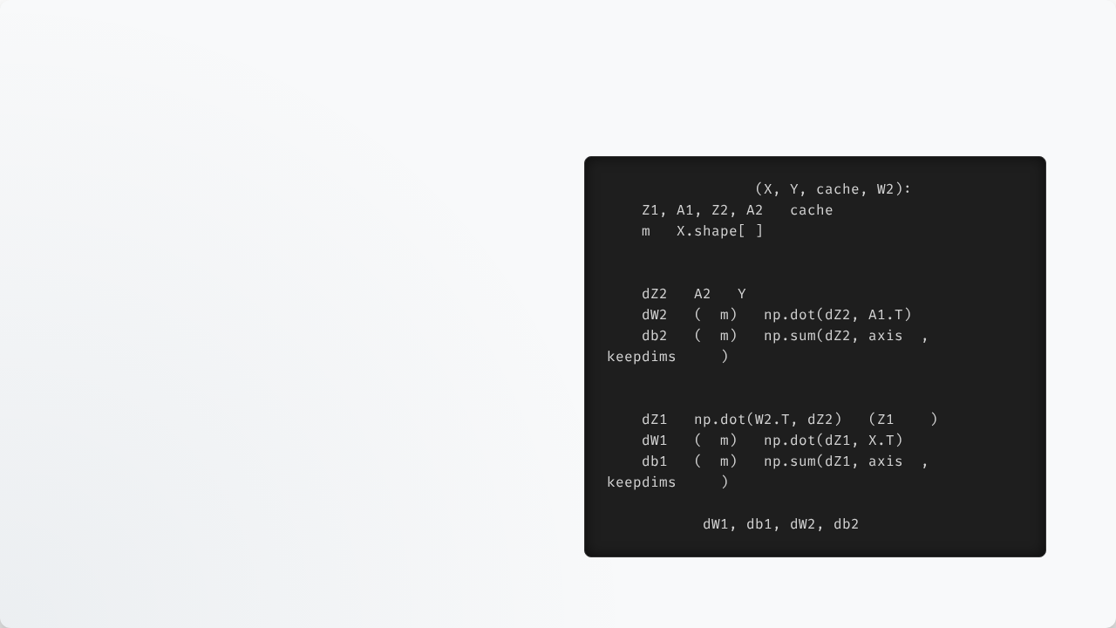
Code: Backward Pass
Calculating Gradients
def
backward_prop
We retrieve our stored values from the cache.
=
=
1
We calculate the error at the output layer (dZ2), derive gradients for layer 2, then propagate the error back to layer 1 (dZ1) through the ReLU derivative.
# Layer 2 gradients
=
-
=
1
/
*
=
1
/
*
=
1
=
True
# Layer 1 gradients (includes ReLU deriv)
=
*
>
0
=
1
/
*
=
1
/
*
=
1
=
True
return

Slide 24
The Training Loop
Initialize: Set weights and biases to small random values.
Forward Pass: Push data through the network to get a prediction.
Compute Loss: Measure how wrong the prediction was.
Backward Pass: Calculate the gradients for all parameters.
Update Parameters: Adjust weights using Gradient Descent.
Repeat: Do this thousands of times (Epochs).

Slide 25
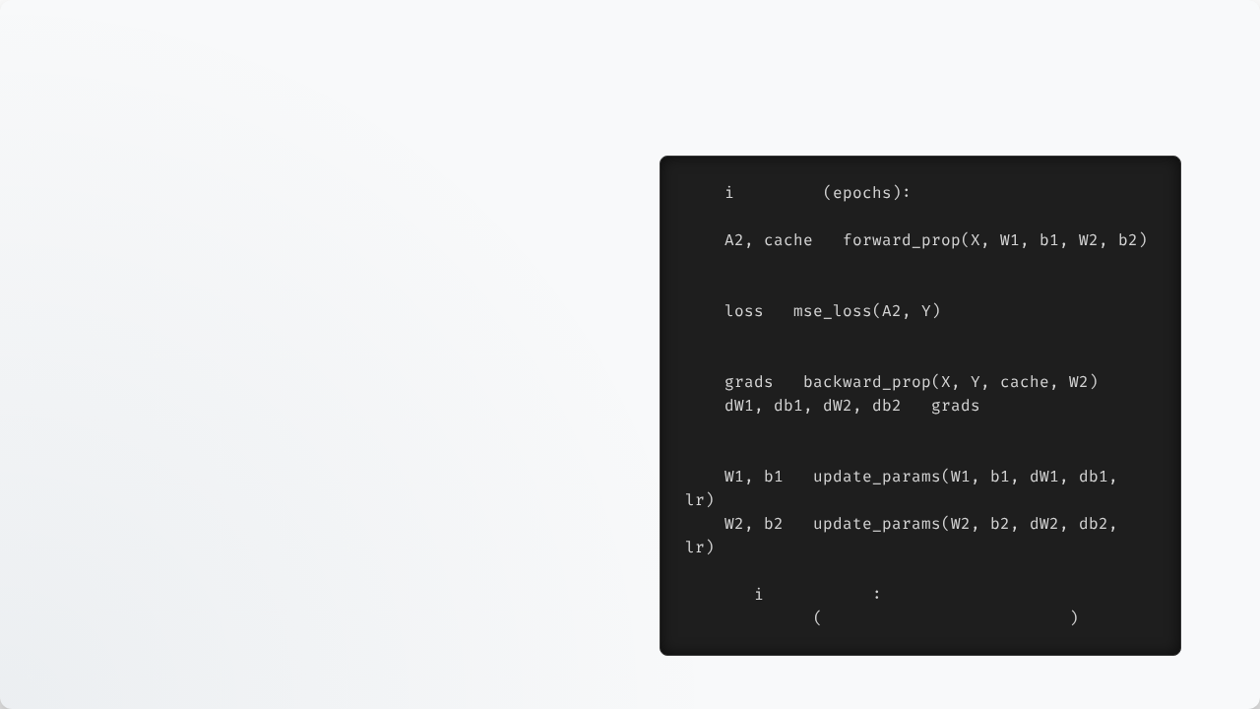
Code: Training Loop
Bringing it together
for
in
range
This is the core training orchestrator. We iterate for a set number of epochs.
# 1. Forward Pass
=
Printing the loss every 100 epochs helps us ensure our model is actually learning and our gradients are correct.
# 2. Compute Loss
=
# 3. Backward Pass
=
=
# 4. Update Weights
=
=
if
%
100
==
0
print
f"Epoch {i}: Loss {loss}"

Slide 26



Overfitting & Regularization
L2 Regularization
Dropout
Early Stopping
Adds a penalty to the loss function based on the size of the weights, preventing any single feature from dominating.
Randomly disables a percentage of neurons during training, forcing the network to learn robust, distributed features.
Monitors validation error and halts training as soon as the model begins to perform worse on unseen data.

Slide 27
Lab 2 Introduction
Training and Evaluating the Network

Slide 28
Lab 2 Tasks
Loss & Gradients: Implement mse_loss and the backward_prop functions in NumPy.
Optimization: Write the update_params function.
Dummy Data: Create a simple non-linear dataset (like an XOR logic gate).
Execution: Write the full training loop, run it for 1000 epochs, and verify the loss decreases.

Slide 29
Course Summary
2. Forward Pass
4. Optimization
Linear steps & activation functions to get a prediction.
Updating parameters with gradient descent iteratively.
1. Architecture
3. Backward Pass
Defining network shape, initializing weights & bias matrices.
Calculating loss and distributing error via chain rule.

Slide 30
Questions?

